Slide 1
Shell Bootcamp 2024 3 Reflections for Week #<26/08/2024 – 28/08/2024>
Sunidhi Singh
Date : 30-Aug-2024

Slide 2

About Me
A phrase that represents my motto in life is Dream big, work hard, stay focused

Slide 3

My learnings from this week!

Slide 4
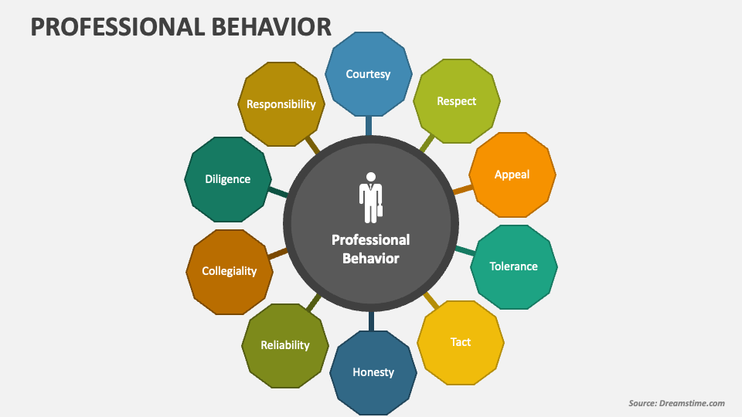
Learning 1 | My takeaways
Please share (in your own words) details of the learning.
Key learning – Professional Behaviour encompasses Integrity, Self awareness , Professional Qualities, Managing Complexity and New world imperatives.
Key takeaway – mindset is how you see the world around you. And your attitude is how you interact with the world according to how you see things
A growth mindset in the energy sector encourages professionals to view challenges as opportunities for innovation. This mindset drives the exploration of new technologies, such as renewable energy, and the adoption of sustainable practices.

Slide 5
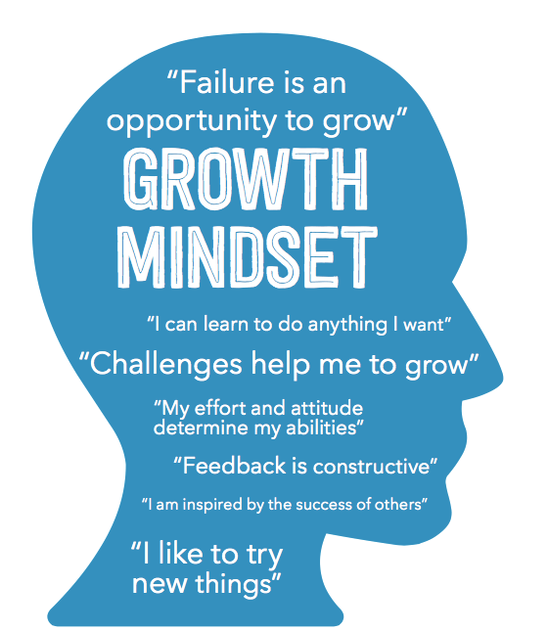
Learning 2 | My takeaways
Please share (in your own words) details of the learning.
Key learning – Neuroplasticity was taken up and discussion ensued regarding Fixed Mindset and Growth Mindset.
Key takeaway – Fixed Mindset believes putting forth effort is worthless while Growth Mindset believes mistakes are an essential part of learning
In a growth-minded energy sector, innovation is seen as a process of trial and error. This perspective allows for more experimentation, leading to breakthroughs in energy efficiency, sustainability, and resource management.

Slide 6
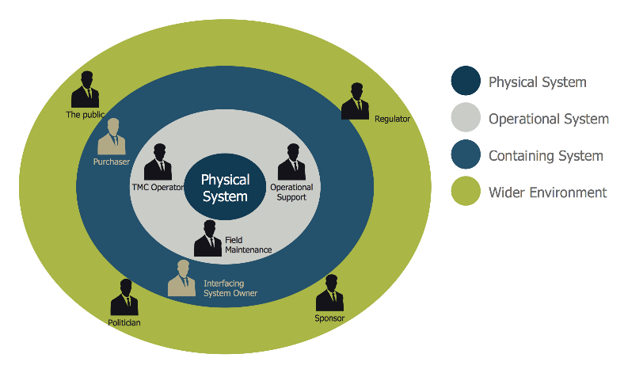
Learning 3 | My takeaways
Please share (in your own words) details of the learning.
Key learning – Stakeholder management was discussed starting with identification of all internal and external stakeholders, planning stakeholder management , engaging and controlling the stakeholders.
Key takeaway – This leads to Enhanced Project alignment , improved risk management and better resource allocation
In the energy sector, this leads to smoother project execution, greater support, and a higher likelihood of success, especially in complex and high-impact energy projects like renewable energy installations or infrastructure upgrades.

Slide 7

Relevance of learnings for my organization

Slide 8
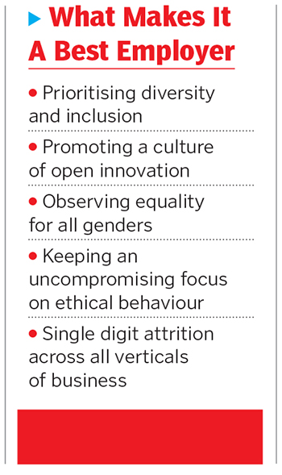
Learning 1 | Relevance for Shell
How I feel Shell implements this learning (in your own words)
Shell implements professionalism by propagating its core values of Honesty , Integrity and Respect among its employees.
How I feel Shell benefits from this learning (in your own words)
Shell benefits by earning the name of a reputed and trustworthy brand, stronger stakeholder relationships , employee morale and retention , resilience in crisis and Long-Term Sustainability.

Slide 9
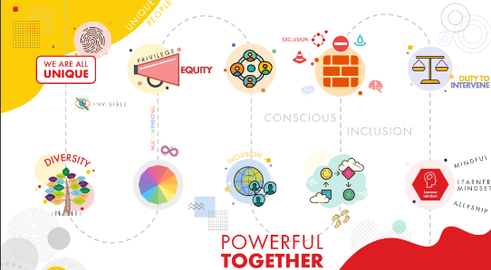
Learning 2 | Relevance for Shell
How I feel Shell implements this learning (in your own words)
Shell implements a Growth Mindset by encouraging its employees to participate in diverse community networks , few of them are SBO women network, LGBT network , enAble network and Young Shell India. Shell also organizes conferences to enable innovation and exchange of new ideas.
How I feel Shell benefits from this learning (in your own words)- Shell creates an environment where employees feel empowered to share ideas, take risks, and experiment. This leads to greater innovation, helping Shell stay ahead in the competitive energy sector.

Slide 10
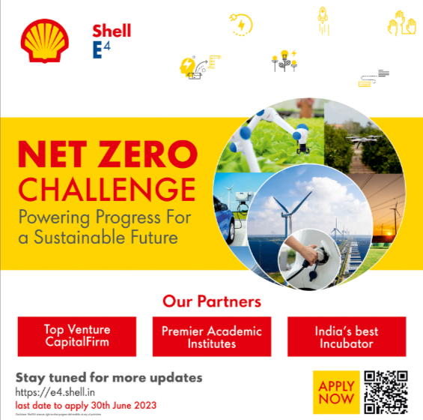
Learning 3 | Relevance for Shell
How I feel Shell implements this learning (in your own words)
Shell implements this through its motto of “Powering Progress” that includes , generating Shareholder value, achieving net zero emissions,powering lives and respecting nature.
By aligning stakeholder management with these goals, Shell ensures that all stakeholders are engaged and managed effectively
How I feel Shell benefits from this learning (in your own words) - By mastering stakeholder management, Shell benefits from more streamlined project execution and greater support from stakeholders. This leads to fewer disruptions, better risk management, and more efficient use of resources.

Slide 11

Challenges in implementing learning

Slide 12

Challenge faced while implementing Learning 1
Maintaining Transparent Communication: Ensuring transparency in communication with all stakeholders can be difficult, especially in sensitive or high-stakes projects. There may be challenges in delivering consistent and clear messages.
Plan to Overcome: Implement structured communication plans and use multiple channels to disseminate information. Regular updates and feedback mechanisms can help maintain transparency and build trust.

Slide 13

Challenge faced while implementing Learning 2
Resistance to Change: Encouraging a shift from a fixed mindset to a growth mindset can be challenging, especially if individuals are accustomed to traditional ways of thinking and working. There may be resistance to embracing new approaches and accepting that mistakes are part of the learning process.
Plan to Overcome: Promote awareness and education about the benefits of a growth mindset. Provide training and workshops that emphasize the value of learning from mistakes and encourage a culture of experimentation and continuous improvement.
Ta

Slide 14
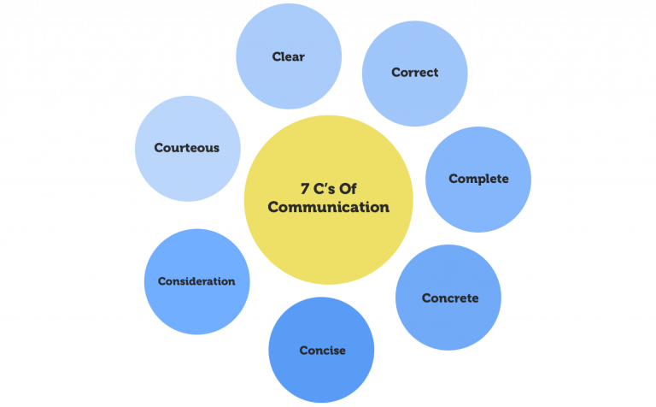
Challenge faced while implementing Learning 3
Engaging Stakeholders Effectively: Engaging stakeholders in a meaningful way can be challenging, especially if there are conflicting interests or if stakeholders are not responsive.
Plan to Overcome: Develop clear communication strategies and tailor engagement approaches to different stakeholder groups. Establish regular touchpoints and feedback mechanisms to address concerns and build strong relationships.

Slide 15

Action Plan

Slide 16
My Action Plan for this Week
Actions
Timeline
Status
1.Attend networking events, workshops, and webinars focused on professional networking. Joining industry-specific groups and communities to expand my network.
2. Select and read books focused on improving communication skills. Implement techniques and strategies from these books in your daily interactions.
1.Participate in at least one networking event per month and engage in relevant online communities weekly.
2. Choose and start reading a book within the first week, aiming to complete it and start applying the concepts within the following month.
1.Research and identify upcoming networking events and online communities to join.
2. Identify and acquire a book on effective communication; begin reading.

Slide 17

Learning is also Fun!

Slide 18
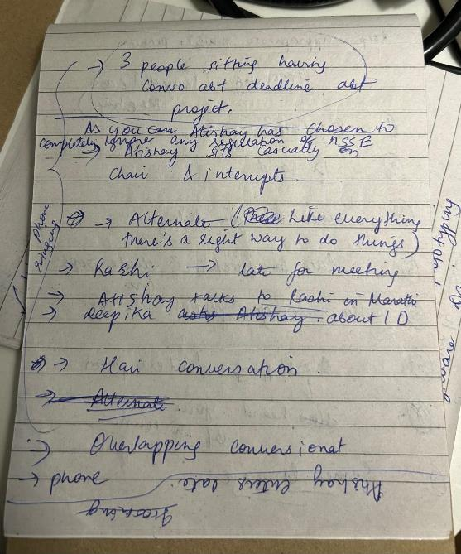
Learning is also Fun!
Please share how ”Your” learning was fun this week
We had a role play on professionalism and grooming. Our group simulated a team meeting where members broke code of conduct and created distractions in the meeting which was commented on and corrected in alternate situations and a case study where we had to identify stakeholder in Neha’s life.

Slide 19

Summary
Transitioning from college to a corporate environment involves adopting a growth mindset, which fosters adaptability and continuous learning, as opposed to a fixed mindset that views abilities as static. Effective stakeholder management is crucial in the corporate world, ensuring successful project outcomes through careful identification, engagement, and control of stakeholders. Grooming plays a key role in making positive first impressions and maintaining professional credibility. Additionally, embodying professional qualities such as reliability and effective communication is essential for building trust and succeeding in a corporate setting. Together, these elements support a smooth transition from academic life to a professional career.
The upcoming week engages us with technical aspects of the training
The upcoming week will also commence with team activities and the trust and communication along with adaptability and respect taught to us in the Sift Skills session will ensure smooth completion of projects.

Slide 20
Thank You

